Slide 1
Historical Context, Types, and Applications of Robots

Slide 2
Outline
Historical Context of Robotics
Robot “definition”
Types of robots
Applications of robotics
2

Slide 3
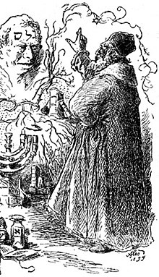
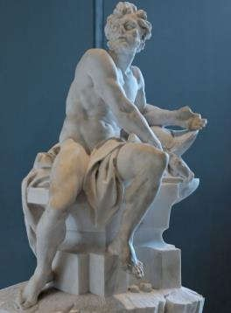
Some Context …
Chinese legends : Yanshi (an artisan) presented a creature that looked and moved as a human
Jewish legends : Golem, an artificial anthropomorphic being that was alive (Loew, a Rabbi, “gave life” to it)
Greek Mythology: Hephaestus (god of fire, metalworking, blacksmiths, sculptors, etc) built golden servants who helped people
Golem “Creation”
Hephaestus
[Images from Wikipedia]
3

Slide 4
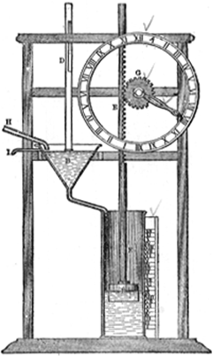
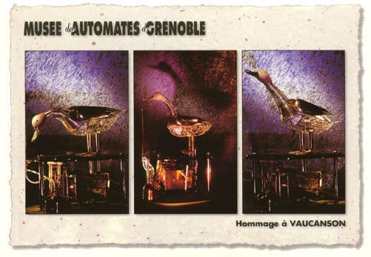
Some Context …
322 A.C. Aristotle: “If every tool, when given an order, could do the indicated work … there would be no need of apprentices or slaves”
200 A.C. Ctesibus of Alexandria: he designed water clocks with movable parts
1738: Jacques de Vaucanson: he built a mechanic duck and a flute player (“movable anatomy”)
4

Slide 5
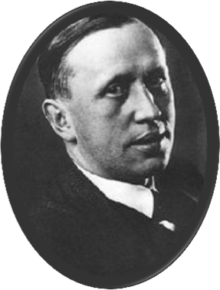


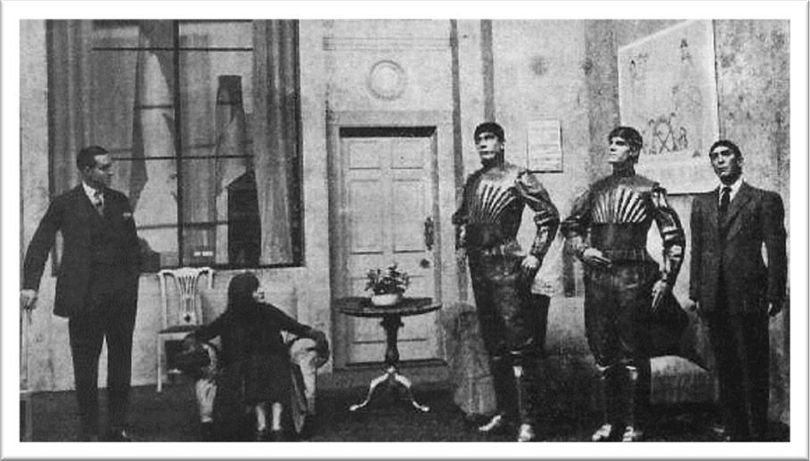
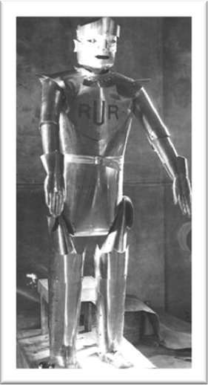
Origin of the word “Robot”
Karel Čapek (1920):
Science fiction play R.U.R. “ Rossum’s Universal Robots”
(“Rossumovi Univerzální Roboti”)
Robota (in czech) = forced laborer
Čapek’s play Čapek’s “Robot”
Summary: humans create robots, then robots destroy humans.
More details about the plot in : https://en.wikipedia.org/wiki/R.U.R.
5

Slide 6

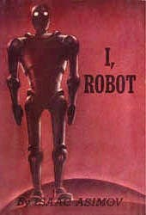
First use of the word “Robotics”
Isaac Asimov (1920-1992)
  He used the word “robotics” (in science fiction plays)
  Some of his books: I, Robot (1950), Robots and Empire (1985)
He wrote the so-called “robotics laws” (in science fiction):
    A robot may not injure a human being or, through inaction, allow a human being to come to harm.
    A robot must obey orders given by humans, except where such orders would conflict with the 1st law.
    A robot must protect its own existence as long as such protection does not conflict with the 1st or 2nd law.
6

Slide 7
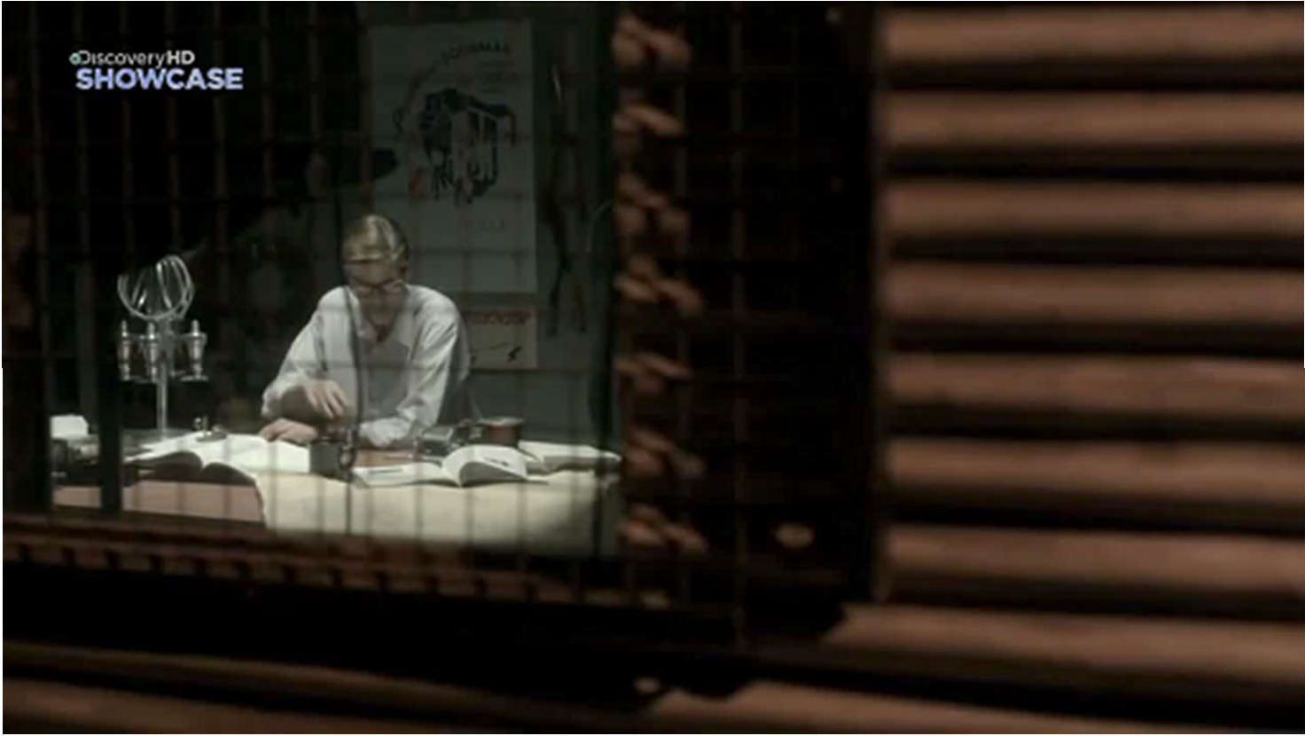
(Short) History of Robotics
Industrial Robots History (South Australia Documentary)
https://youtu.be/HVLbtrlL5_E
7

Slide 8
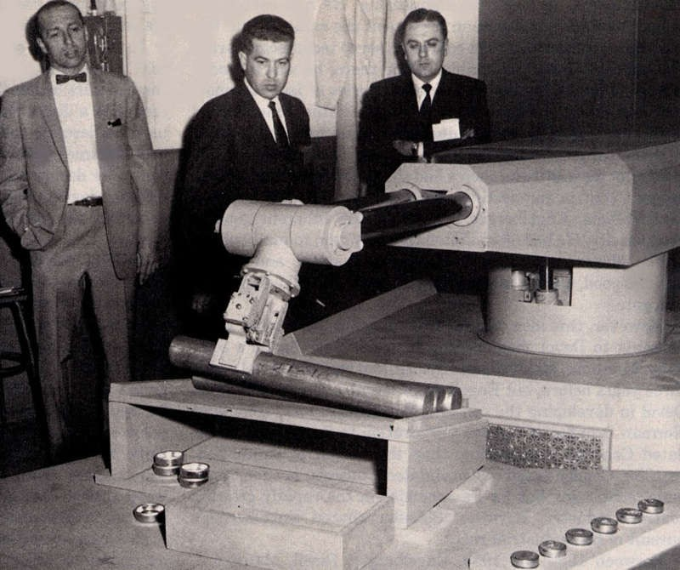
(Short) History of Robotics
First industrial robot:
  Developed by George C. Devol and Joseph Engelberger.
  They met in 1956 in a cocktail, talking about Asimov’s “philosophies”.
  They founded “Unimation”
  They built the first industrial robot: “Unimate”
Joseph Engelberger (1925-2015)
  Considered as the: “father of robotics”
http://spectrum.ieee.org/automaton/robotics/industrial-robots/george-devol-a-life-devoted-to-invention-and-robots http://www.robotics.org/joseph-engelberger/about.cfm
8

Slide 9

(Short) History of Robotics
First industrial robot: Unimate (1962)
[British Movietone: https://youtu.be/hxsWeVtb-JQ]

Slide 10
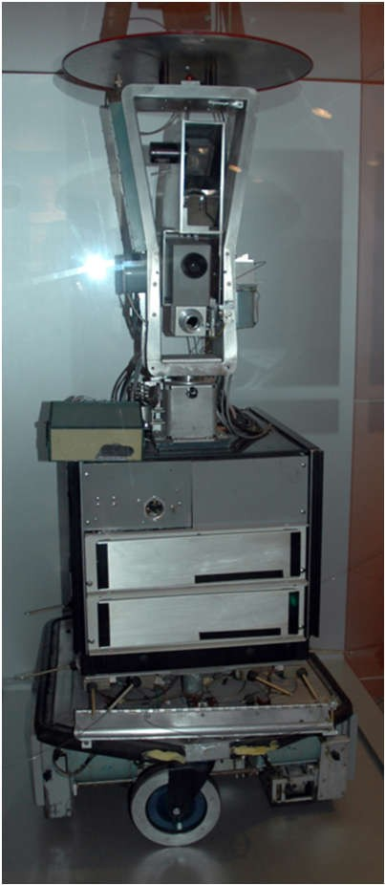
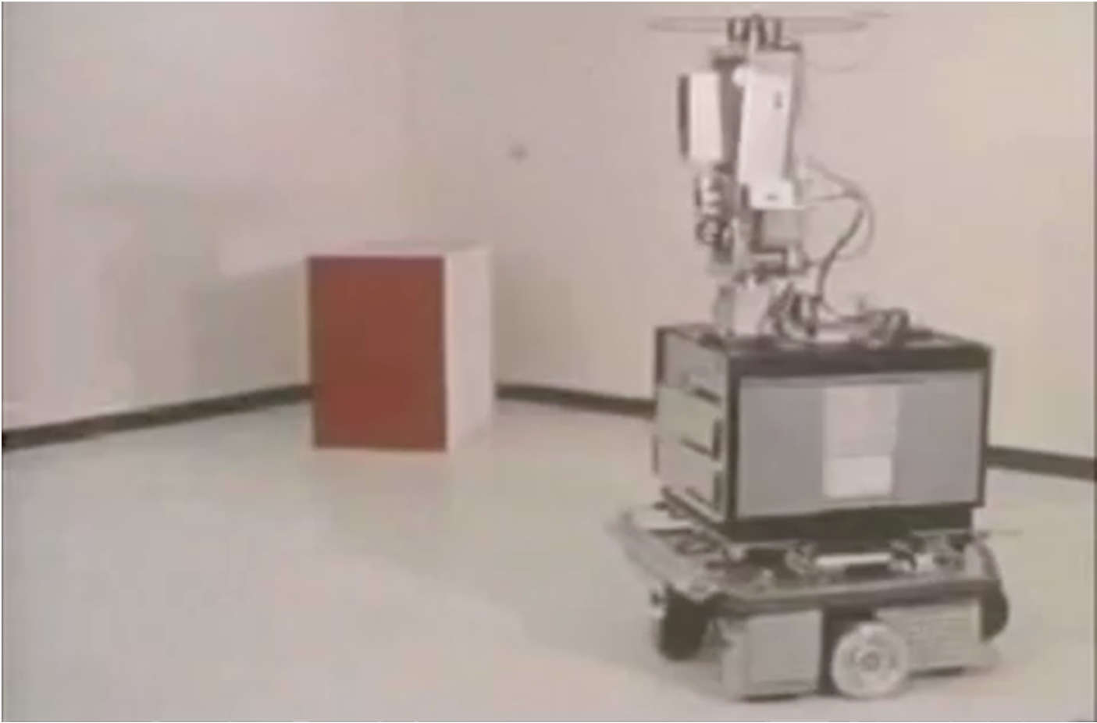
(Short) History of Robotics
First “intelligent” mobile robot: Shakey (1966-1967)
AI Lab of Stanford Research Institute: https://youtu.be/qXdn6ynwpiI

Slide 11
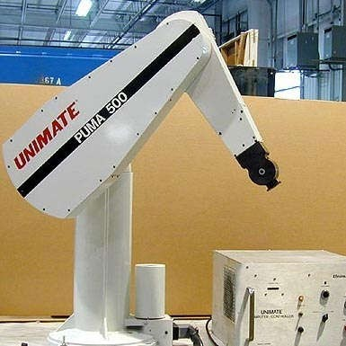
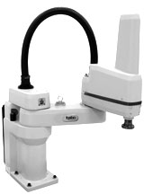
(Short) History of Robotics
End of the 70s:
  2 “popular” robots are developed
  1978: Unimation unveils the PUMA (Programmable Universal Machine for Assembly) robot
  1979: Sankyo Seiki, PENTEL and NEC developed SCARA (Selective Compliant Articulated Robot Assembly)
Robot PUMA
[Image of Antenen Robotics]
Robot SCARA
[Image of Adept Technology]
11

Slide 12
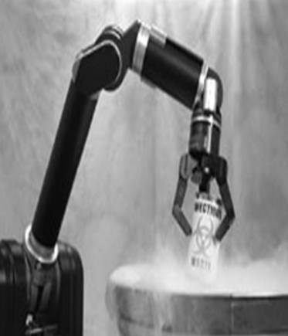
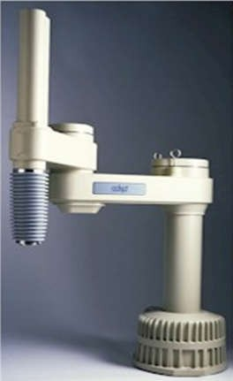
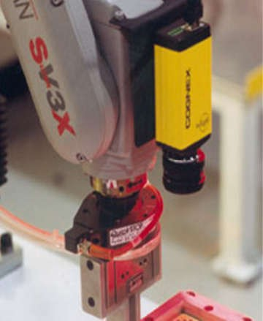
(Short) History of Robotics
In the 80s:
  Fast growth of the robotics industry
  The performance is increased: feedback control + redesign
  Many universities introduce robotics in their curricula (also in research)

Slide 13
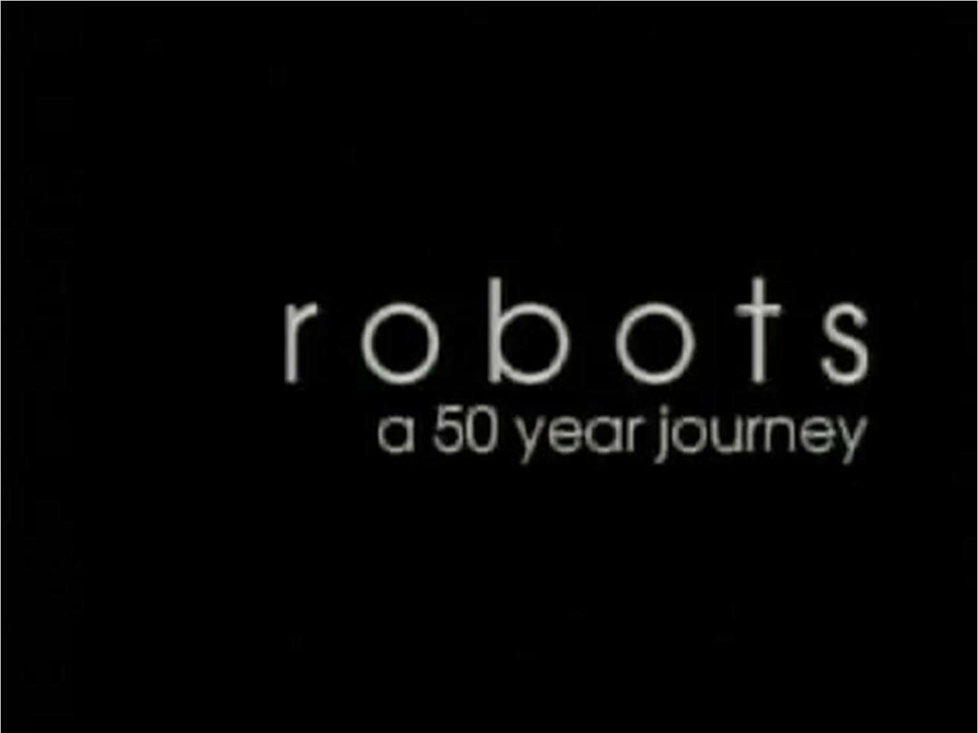
(Short) History of Robotics
Robots a 50 year journey (IEEE ICRA 2000)
Edited by Oussama Khatib: https://youtu.be/p_RfxPaGfl4

Slide 14

(Short) History of Robotics
Robots – The journey continues
(Multimedia Extension, Springer Handbook of Robotics, 2016)
Edited by B. Siciliano, O Khatib, T. Kröger: https://vimeo.com/173394878

Slide 15
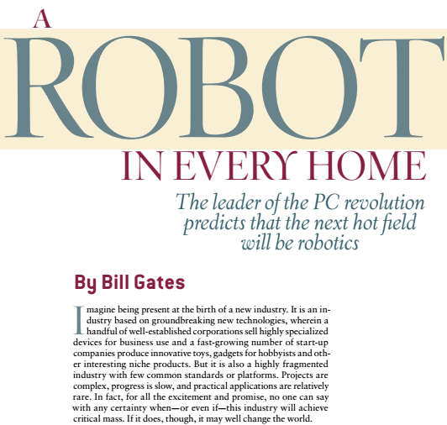
What will happen next?
Gates, Bill. "A robot in every home." Scientific American 296.1 (2007): 58-65.

Slide 16
Outline
Historical context of robotics
Robot “Definition”
Types of robots
Applications of robots

Slide 17
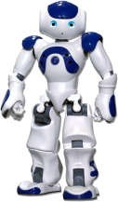
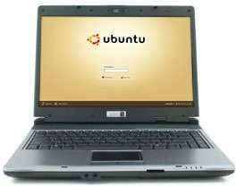
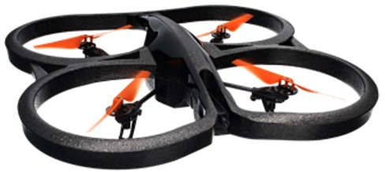
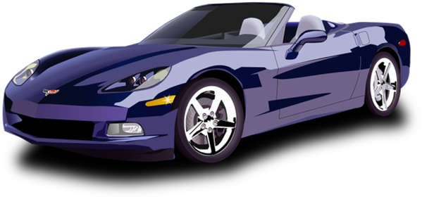
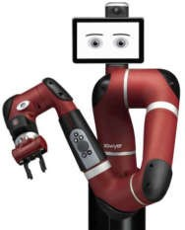
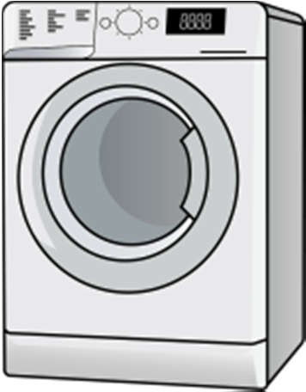
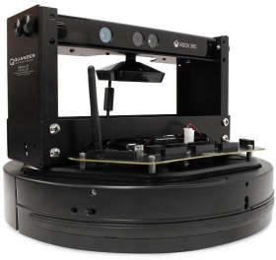
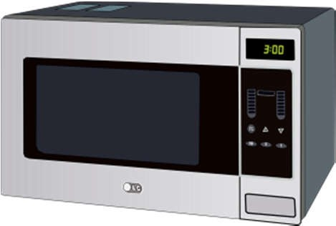
What is a robot?

Slide 18


What is a robot?
Robot Institute of America (RIA), 1979¹:
A robot is a reprogrammable and multifunctional manipulator designed to move materials, parts, tools, or specialized devices through various programmed motions for the performance of a variety of tasks.
Japanese Industrial Robot Association (JIRA)²:
A robot is a device with degrees of freedom that can be controlled.
¹ https://www.robotics.org/
² http://www.jara.jp/e
18

Slide 19
What is a robot?
International Federation of Robotics (IFR): ISO 8373:2012
A robot is an actuated mechanism programmable in two or more axes with a degree of autonomy, moving with its environment to perform intended tasks.
Remark 1: A robot includes the control system and interface of the control system.
Remark 2: The classification of a robot into industrial robot or service robot is done according to its intended application.
Autonomy: Ability to perform intended tasks based on current state and sensing, without human intervention.
https://www.iso.org/obp/ui/#iso:std:iso:8373:ed-2:v1:en

Slide 20
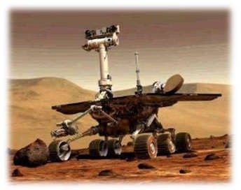
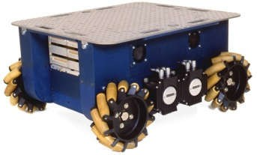
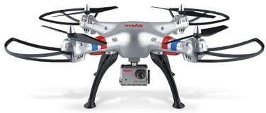




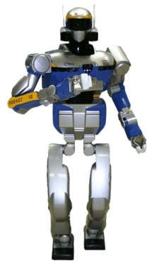
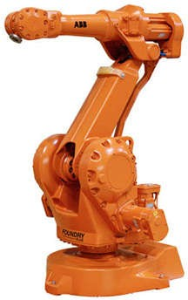
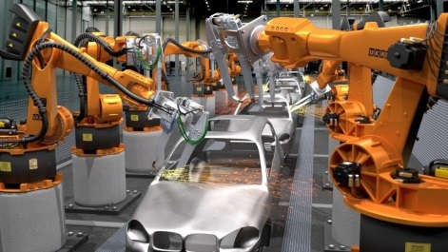
What is a robot?
Variety of tasks
Reprogrammable mechanism
interacts
Environment
independent (and “intelligent”) actions
Variety of tasks

Slide 21
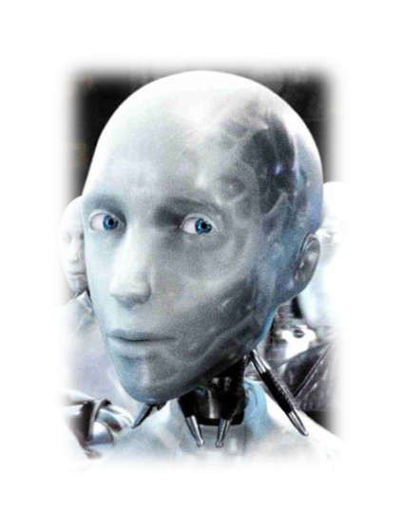




What is a robot?
From a “visionary” perspective:
Intelligent connection between action and perception
Where AI meets the real world
AI: Artificial Intelligence

Slide 22
Outline
Historical context of robotics
Robot “definition”
Types of Robots
Applications of robots

Slide 23
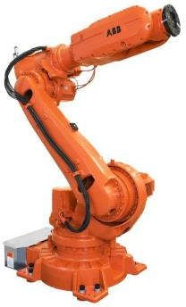
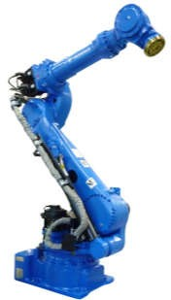
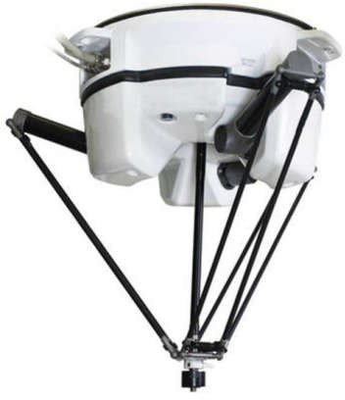
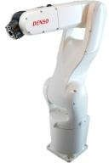
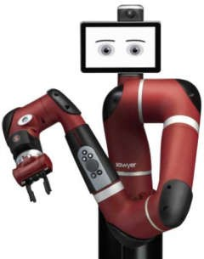
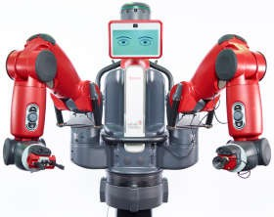
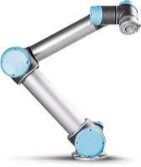
Types of Robots
Manipulators
They can be:
a. Industrial Robots
b. Collaborative Robots (“cobots”)

Slide 24
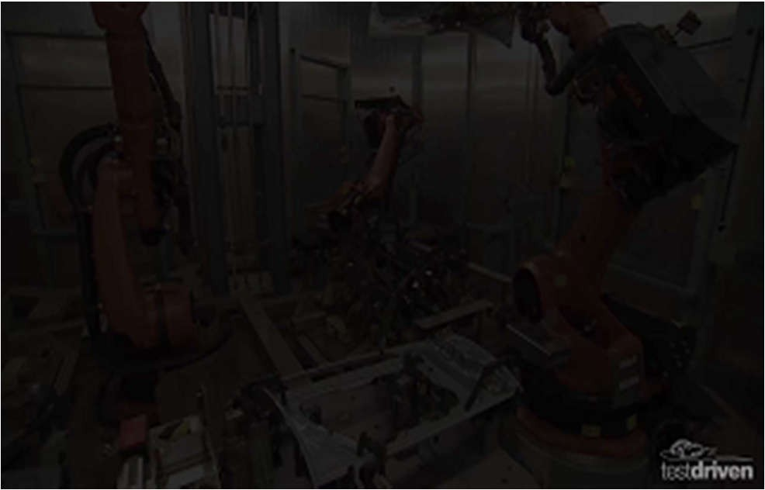
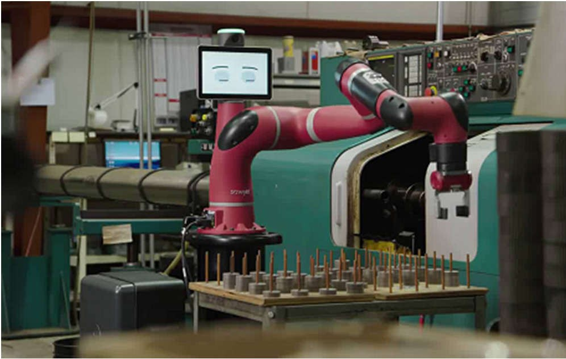
Types of Robots
Manipulators
Also known as: robotic arms, robotic manipulators
Industrial robot industrial in a vehicle assembly line
Collaborative robot Sawyer: “Let’s Rethink Automation”
Mercedes A-Class Production Line https://youtu.be/VreG1iC65Lc
Rethink Robotics https://youtu.be/-kiq2onigm4

Slide 25
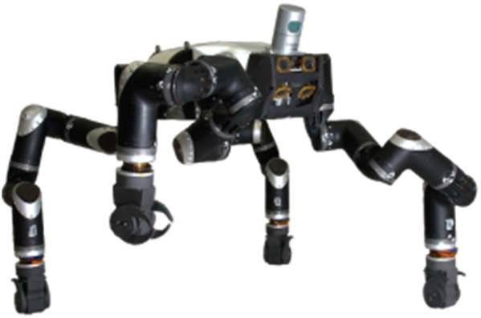
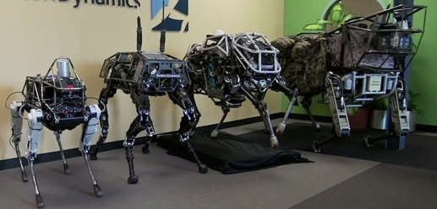
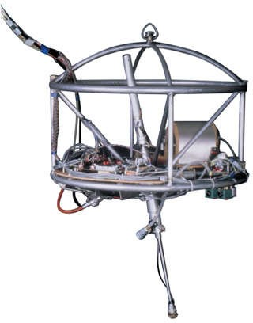
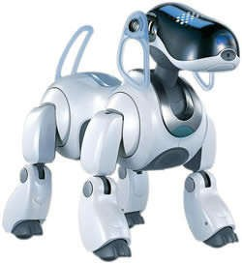
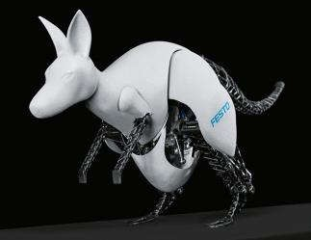
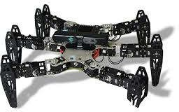
Types of Robots
Terrestrial Mobile Robots
Legged Mobile Robots
RoboSimian
Boston Dynamics’s Robots
@MIT
Aibo
Festo’s Robot

Slide 26
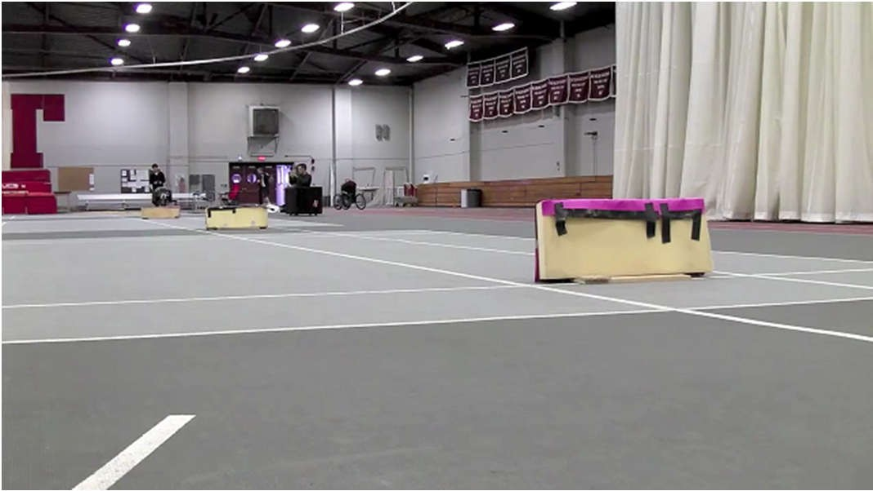

Types of Robots
Terrestrial Mobile Robots
Cheetah Robot (MIT)
https://youtu.be/_luhn7TLfWU
Spot Mini (Boston Dynamics)
https://youtu.be/kgaO45SyaO4

Slide 27








Types of Robots
Terrestrial Mobile Robots
Wheeled Mobile Robots
Robot Podador
Sojourner Rover
Hospi (Panasonic)
EVA (@UCLA)
Turtlebot 3
E-puck
Roomba
@NREC

Slide 28




Types of Robots
Aerial Mobile Robots
Also known as: “Unmanned Aerial Vehicle” (UAV)
Parrot AR. Drone
Erle Hexacopter
Crazyflie 2.0
DJI - Matrice 200

Slide 29

Types of Robots
Aerial Mobile Robots
Vijay Kumar Lab
https://youtu.be/4ErEBkj_3PY

Slide 30



Types of Robots
Underwater Mobile Robots
Also known as “Autonomous underwater vehicles” (AUV)
Mbari robot tiburón
@Heriot Watt
Girona 500

Slide 31








Types of Robots
Mobile Manipulators
PR-2
Reem
Armar
Pepper
Packbot
Momaro
Justin
Spot mini

Slide 32


Types of Robots
Mobile Manipulators
PR-2 and a bottle
https://youtu.be/c3Cq0sy4TBs
Spot Mini opening a door
https://youtu.be/fUyU3lKzoio

Slide 33











Types of Robots
Humanoid Robots
Asimo
Hubo
Romeo
HRP-4C
Toro
Atlas
Schaft
Kenshiro
Valkyrie
Sarcos
Talos

Slide 34


Types of Robots
Humanoid Robots
HRP-2 at LAAS-CNRS, Toulouse, France
https://youtu.be/pVSvtknTlE4
Atlas (Boston Dynamics )
https://youtu.be/fRj34o4hN4I

Slide 35


Types of Robots
Hybrid Humanoids
Ocean One
https://youtu.be/p1HmgP9l4VY
Handle
https://youtu.be/-7xvqQeoA8c

Slide 36





Types of Robots
Micro Robots
Harvard’s Robobee
https://youtu.be/hEZ7rHRifVc
Max Planck’s micro-scallop
https://youtu.be/eZ05z6ebKDQ
Technion: ViRob
MIT, TUMunich: Self-assembling origami robots
https://youtu.be/f0CluQiwLRg
SRI International: micro-manufacture
https://youtu.be/uL6e3co4Qqc

Slide 37






Types of Robots
Soft Robots
Octopus Project (FP7)
https://youtu.be/Xn-bG8_aazM
SoftRobotics, Inc.
https://youtu.be/o8DoSvv4P3w
EPFL, Reconfig Robotics Lab
https://youtu.be/enMlWpHxPDs
Wyss Institute, Artif. Muscles
https://youtu.be/_tKI8BUHFLo
Columbia Univ. Soft materials
https://youtu.be/1J47difr3oo
Harvard’s Whitesides Group
https://youtu.be/2DsbS9cMOAE

Slide 38









Types of Robots
Other Types
Snake Robot (CMU)
Salamander Robot EPFL)
Exoskeletons
Geminoid (Ishiguro Lab, Osaka)
Sophia (Hanson Robotics)
XLR (UPenn)
Hand
Legged chair

Slide 39




Types of Robots
Classification According to the Application
Industrial Robots
  Used in industrial automation applications (manufacture, inspection, packing, assembly, etc.)
Service Robots
  They perform tasks for humans or other equipment, excluding industrial automation applications
Personal
Used for non-commercial tasks by common (untrained) people
Professional
Used for commercial tasks by trained people
Domestic robots
Automated wheelchairs
Personal assistants
Robots for entertainment
Etc.
Robots to clean public places
Delivery robots
Firefighting robots
Robots for rehabilitation and surgery
Etc.
https://www.iso.org/obp/ui/#iso:std:iso:8373:ed-2:v1:en
39

Slide 40
Outline
Historical context of robotics
Robot “definition”
Types of robots
Applications of Robotics

Slide 41


Applications
What should robots be able to do?
DARPA Robotics Challenge (DRC): 2012-2015
“… develop human-supervised ground robots capable of executing complex tasks in dangerous, degraded, human-engineered environments”
Originated from the Fukushima nuclear disaster
https://www.darpa.mil/program/darpa-robotics-challenge

Slide 42




Applications
What should robots be able to do?
DARPA Robotics Challenge (DRC): 2012-2015
https://www.darpa.mil/program/darpa-robotics-challenge

Slide 43



Applications
Where can robots be used?
Dangerous tasks for humans
Repetitive, boring, stressful or intense tasks
Motion with high precision (example: medicine)
Disgusting tasks for humans (example: ¿cleaning?)
Human entertainment
Etc…
North Rhine-Westphalia State Office of Criminal Investigation
43

Slide 44




Applications
Industrial Robots
Assembly
Materials handling
Manipulation (“pick and place”)
Spot and arc welding
Laser cut
Painting (spray layers)
Inspection
Etc.
44

Slide 45




Applications
Indoors Service Robots
Customer support (example: museums)
Cleaning
Health care: hospitals
Entertainment
Logistics and transportation (example: Amazon)
Warehouses
…
Roomba
http://www.robot-entertainment.com
Robocup
Amazon Robotics
45

Slide 46




Applications
Outdoors Service Robots
Transportation: autonomous vehicles (example Goo
Military: demining, surveillance, atack
Exploration: space, forests, sea, volcanoes
Mining: excavation and exploration
Delivery (example: Amazon)
Agriculture
Construction, etc.
Amazon Robotics
gle)
Google cars
NASA’s Curiosity
Autonomous Tractor (John Deere)
46

Slide 47

Applications
Service Robots in Medicine
Da Vinci robot performing surgery through teleoperation
https://youtu.be/VJ_3GJNz4fg
47

Slide 48



Applications
Service Robots in Medicine
DaVinci Robot
Robot for THR (total hip replacement)
https://youtu.be/fSU_R9mgeSg
Robotic Prosthesis
(Johns Hopkins University)
https://youtu.be/9NOncx2jU0Q
48

Slide 49

Applications
The World of KUKA Robotics
https://youtu.be/jDi3RxboDdg
49

Slide 50
References
B. Siciliano and O. Khatib, eds. Springer Handbook of Robotics. Springer Science & Business media, 2016 (http://handbookofrobotics.org)
B. Siciliano, L. Sciavicco, L. Villani and G. Oriolo. Robotics: Modelling, Planning and Control. Springer Science & Business Media, 2010 (Capítulo 1)
50

